Slide 1
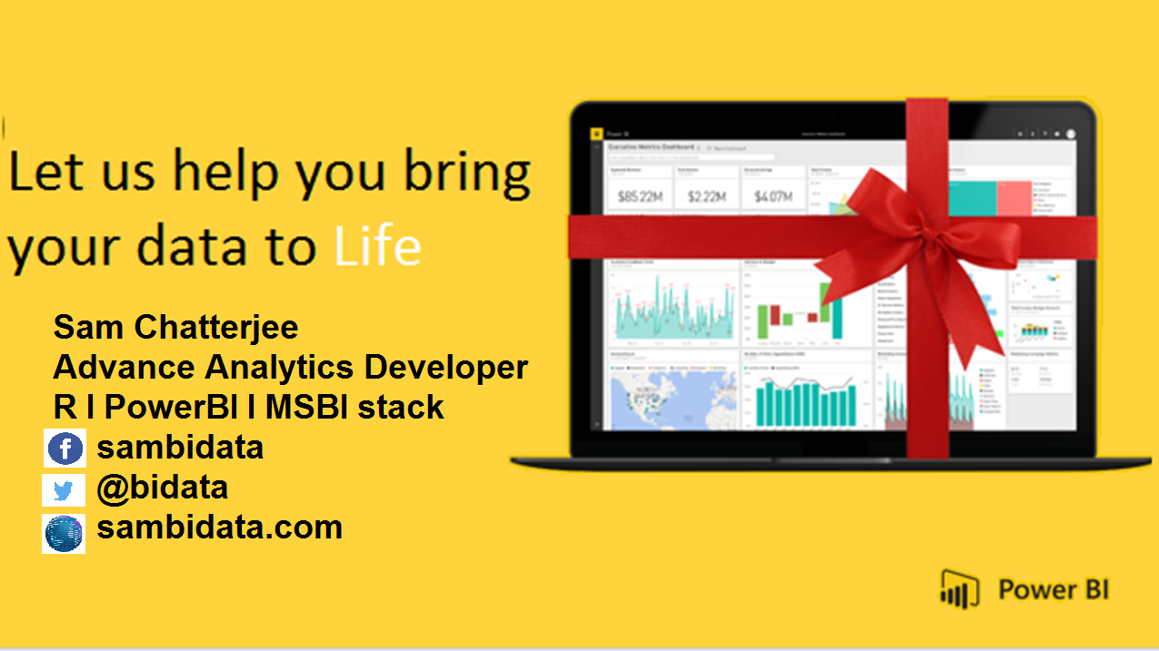

Slide 2

D A X
DATA ANALYSIS AND EXPRESSIONS

Slide 3
Why We need to Learn DAX?
DAX is a formula language associated with the Data modelling.
DAX contains important functions that can be use in Excel Power Pivot.
DAX is only associate with PowerBI.
It’s quite easy to create a new Power BI Desktop file and import some data into it. You can even create reports that show valuable insights without using any DAX formulas at all. But, what if you need to analyze growth percentage across product categories and for different date ranges? Or, you need to calculate year-over-year growth compared to market trends? DAX formulas provide this.
DAX associated with PowerBI

Slide 4
How will you Learn DAX?
By practicising it with your datasets.
By analysing the data and the query given.
What will you gain after DAX?
Creation of amazing data modelling and functions.
It works with relational databases that perform dynamic aggregations.
Can create the difference between excel and dax functions.

Slide 5

How a DAX function is written?

Slide 6
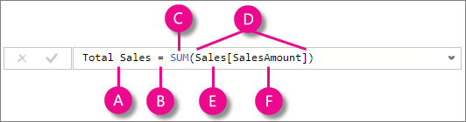

This formula includes the following syntax elements:
A. The measure name Total Sales.
B. The equals sign operator (=) indicates the beginning of the formula. When calculated, it will return a result.
C. The DAX function SUM adds up all of the numbers in the Sales[SalesAmount] column.
D. Parenthesis () surround an expression containing one or more arguments. All functions require at least one argument. An argument passes a value to a function.
E. The referenced table Sales.
F. The referenced column [SalesAmount] in the Sales table. With this argument, the SUM function knows on which column to aggregate a SUM.
When trying to understand a DAX formula, it is often helpful to break down each of the elements into a language you think and speak every day. For example, you can read this formula as:

Slide 7
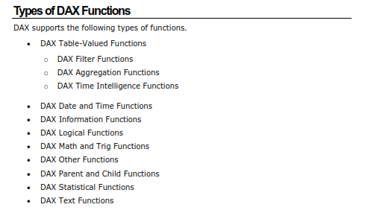
DAX Functions

Slide 8
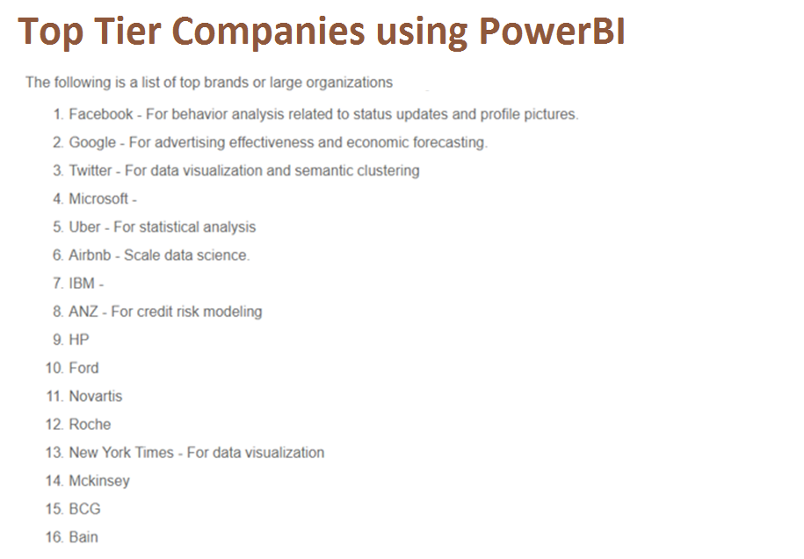
What will you achieve with PowerBI

Slide 9
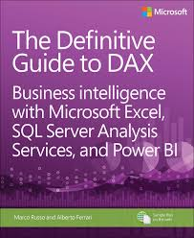

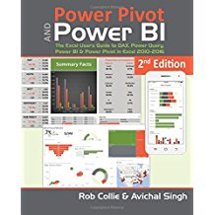

Resources
Get Power BI (Free) http://tinyurl.com/hj5hdg6
Power BI Jump Start http://bit.ly/1ktON16
Power BI Getting Started http://bit.ly/1FF88KA
Power BI Team Blog http://bit.ly/1vwbTLG
Power BI Channel 9 http://bit.ly/1a9Q0gv
Power BI https://powerbi.microsoft.com

Slide 10
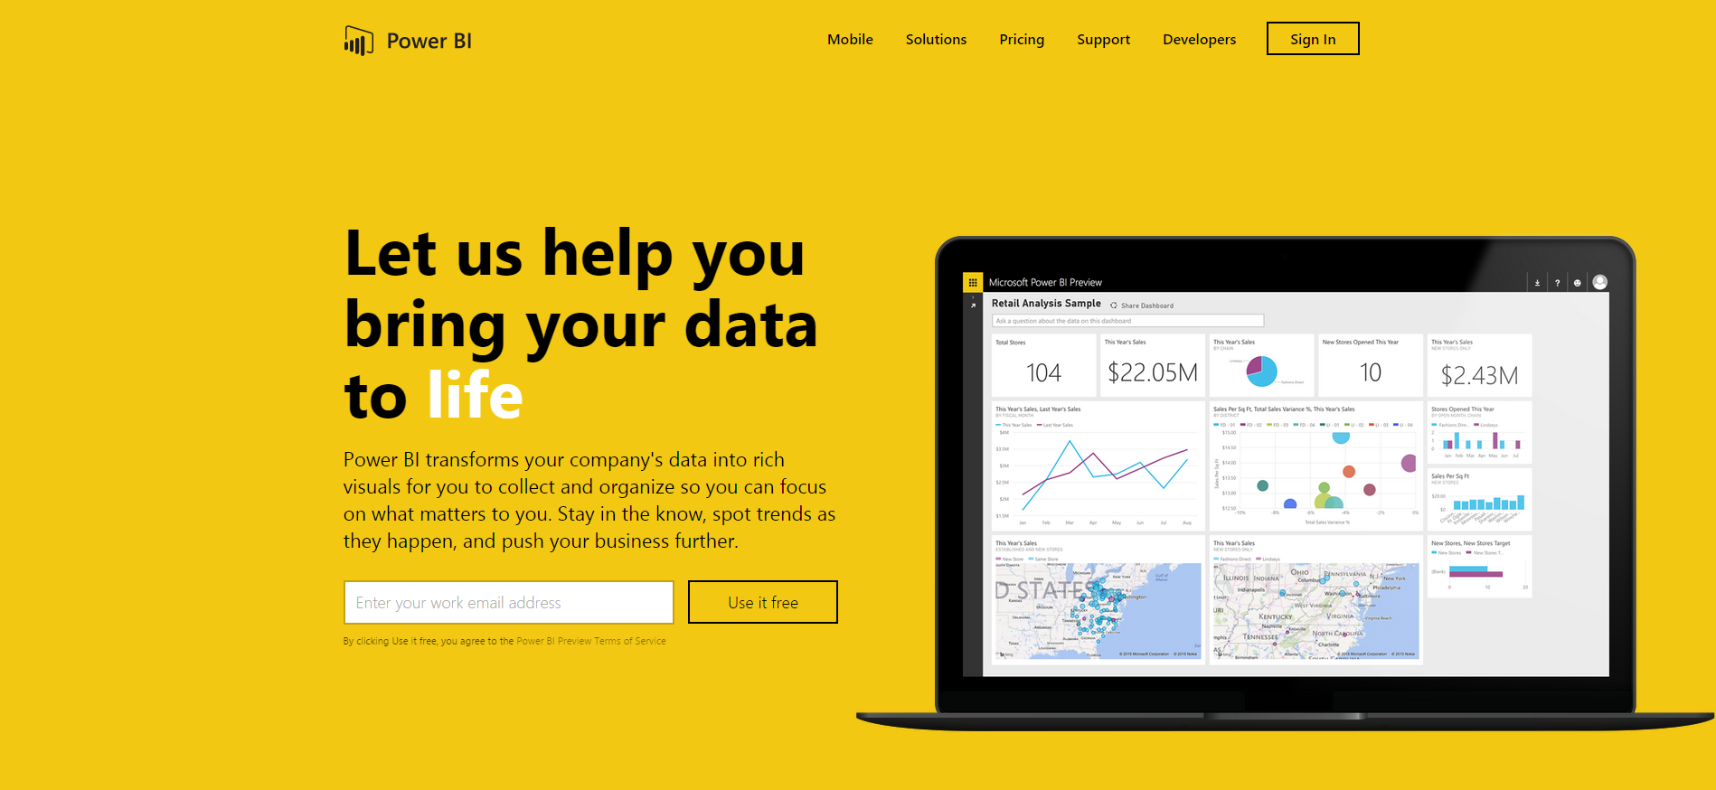
Thankyou for Coming to PowerBI
Sign up for a free Preview account
Take the Power BI Tour
Notes:
Thanks for taking the time to walk through the main capabilities of Power BI.
If you’re ready to start exploring what Power BI can do for you and your organization, please visit powerbi.com.

